Slide 1
FOSB WG Metadata & Standardization FOSB WG RDM & OS - subWG KPI
29/09/2020

Slide 2
Agenda
FOSB WG Metadata & Standardization
Open Data
Definition
Indicators
FAIR Data
Definition
Indicators
Future Open Access

Slide 3
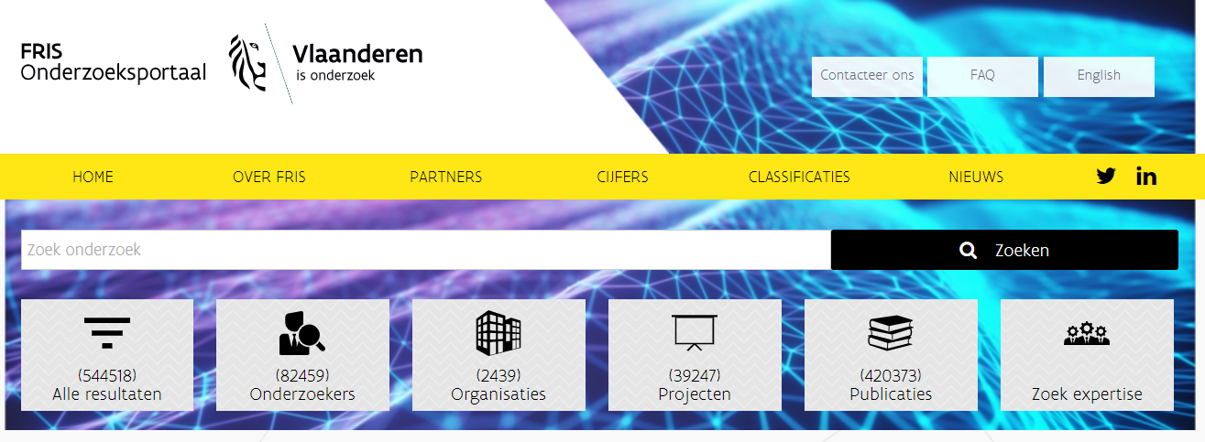
FOSB WG Metadata & Standardisation
In accordance with FOSB WG RDM&OS - subWG KPI
Generic model (DataCite/OpenAire)
FRIS (researchportal.be)
EOSC
Aligned with FAIR indicators
Semantically harmonized amongst Flemish information providers

Slide 4
FOSB Metadata model draft

Slide 5
What are Open Research Data?
The Open Definition:
““Open data can be freely used, modified, and shared by anyone for any purpose”.
Open & machine-readable format
Open license

Slide 6
Why license open data?
Without a licence, data is not truly open.
A licence tells anyone that they can access, use and share your data.
‘Publicly available’ ≠ permission to access, use and share it under copyright or database laws.

Slide 7
User Licenses
License | Domain | By | SA | Comments
Creative Commons CCZero (CC0) | Content, Data | N | N | Dedicate to the Public Domain (all rights waived)
Open Data Commons Public Domain Dedication and Licence (PDDL) | Data | N | N | Dedicate to the Public Domain (all rights waived)
Creative Commons Attribution 4.0 (CC-BY-4.0) | Content, Data | Y | N
Open Data Commons Attribution License (ODC-BY) | Data | Y | N | Attribution for data(bases)
Creative Commons Attribution Share-Alike 4.0 (CC-BY-SA-4.0) | Content, Data | Y | Y
Open Data Commons Open Database License (ODbL) | Data | Y | Y | Attribution-ShareAlike for data(bases)

Slide 8
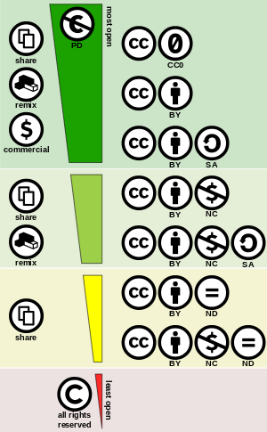
Creative Commons Licenses (Green = open)

Slide 9
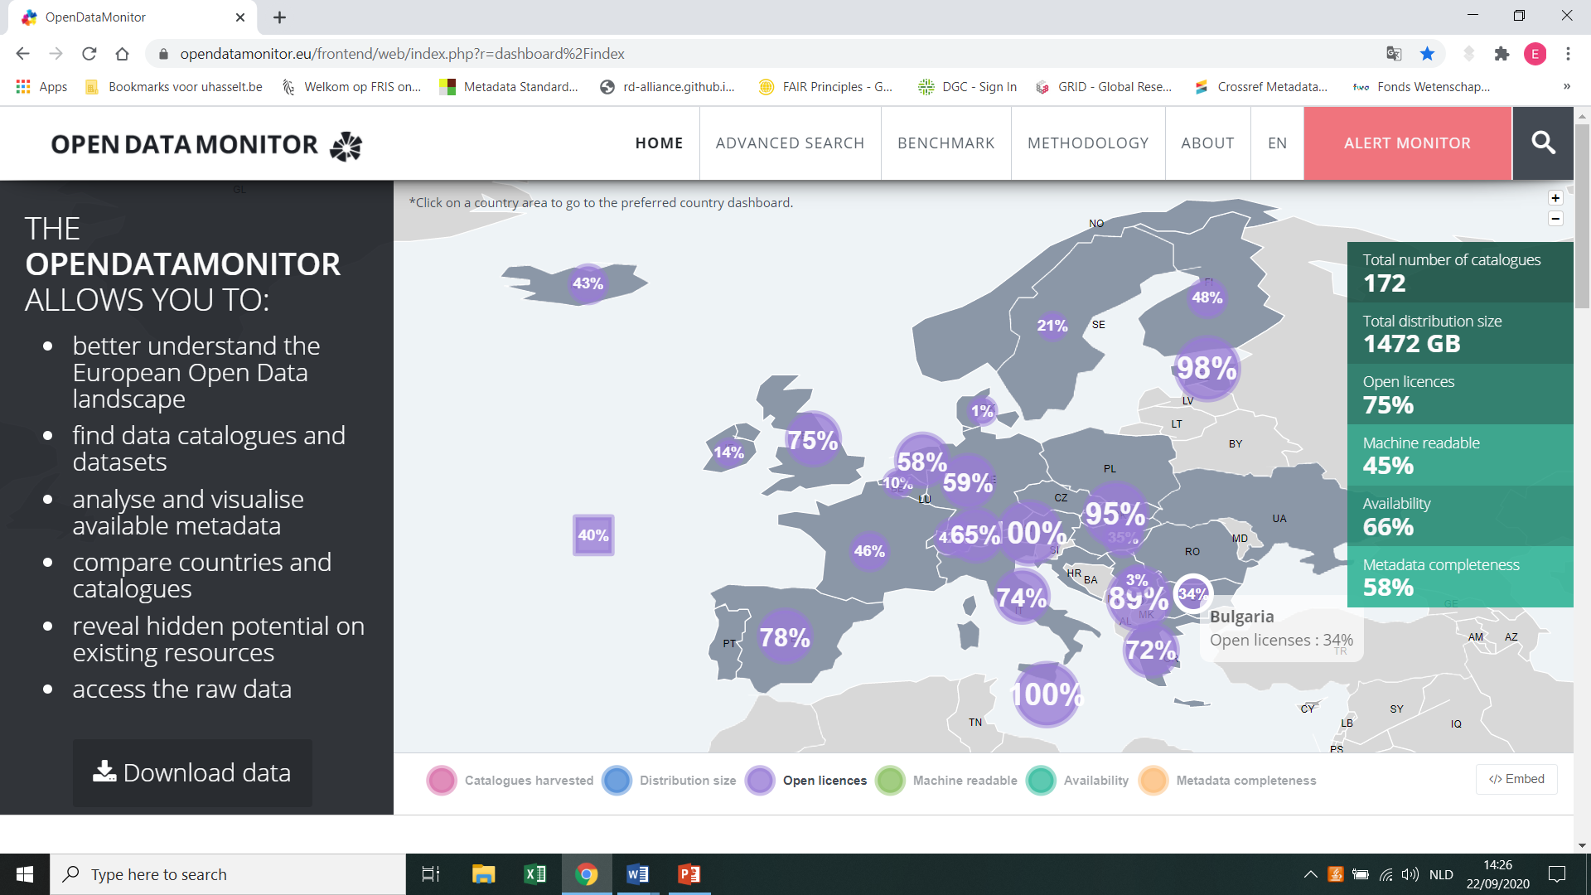
The Open Data Monitor
Availability
Open license
Open formats
Machine-readable
Metadata completeness
Discoverability
Overall Quality

Slide 10
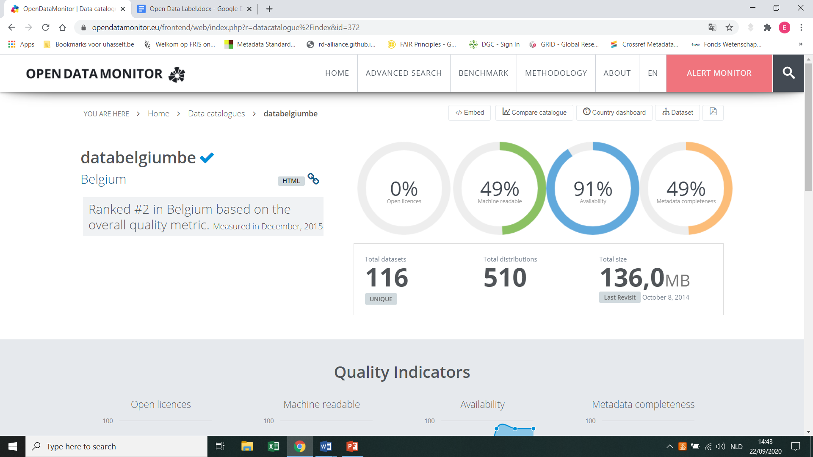
The Open Data Monitor

Slide 11

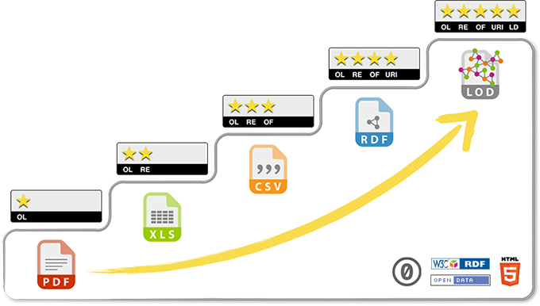
The Open Data Institute
5-stars of Linked Open Data

Slide 12
Open Data Certificate
PID
Open & machine-readable format
Open license
Machine-readable metadata + standard vocabularies
Trusted repositories
Technical info
Contact person

Slide 13
Open Data Label
Option 1: Is the dataset completely open access with no restrictions?
Internationally recognised and machine-readable open license
Open/machine-readable format
Yes/NO => If Yes Open Data Label

Slide 14
Option 2: multidimensional field: degree of openness
1 star: Dataset is available via a DOI leading to a landing page with a downloadable link.
2 stars: Dataset is available in an open/machine-readable format
3 stars: Dataset has an open license

Slide 15

FAIR Principles
RDA FAIR Data Maturity Model WG
FAIRsFAIR project
GO-FAIR

Slide 16

FAIR Data Assessment tool (DANS)
F, A, & I as separate dimensions of data quality
Score datasets on each dimension (1-5)
Reusability = average FAIRness
indicator of data quality
Make scoring automatic

Slide 17

FAIRsFAIR Data Assessment Metrics
15 metrics built on existing work
• RDA FAIR Data Maturity Model
• DANS Fairdat/FAIREnough
• WDS/RDA Data Fitness
Iteratively improve via pilot tests
v0.3 since August 2020

Slide 18
FAIR Scoring and Badging
A ‘sensible’ scoring mechanism to quantify the overall FAIRness of a data object.
Scoring results in a machine-readable format to allow wide re-use by other services (e.g., visualization tools).
A simple & easy-to-understand visualization that summarizes the assessment results.

Slide 19
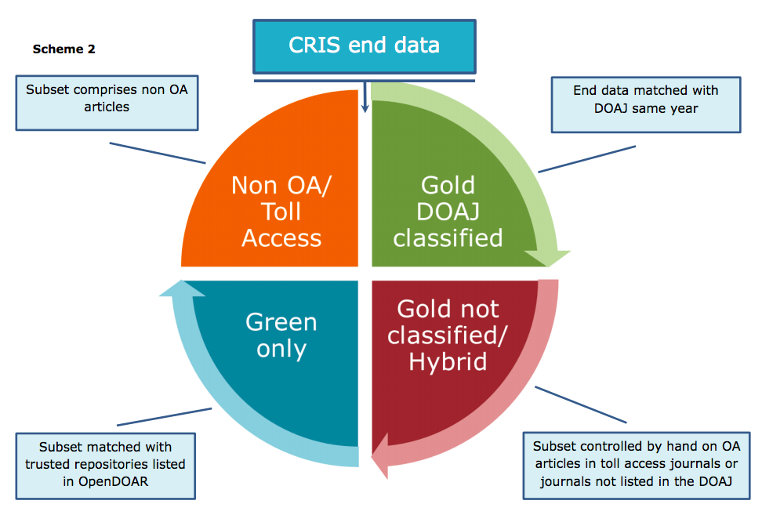
Future Open Access

Slide 20

Questions
Project leader: Sadia Vancauwenbergh
Mail: ECOOM@uhasselt.be
+32(0)474 30 53 54 (Sadia)
+32(0)483 22 52 65 (Evy)
Team:
Simon D’Haenens
Evy Neyens
Hanne Poelmans
Acknowledgement
ECOOM is supported by the Flemish Government, Dept. Economy, Science and Innovation (EWI)

